Slide 1

BIKE SHARING DATA ANALYSIS
POWER BI DASHBOARD PROJECT
NEXTHIKE IT SOLUTION
Prepared by
Manisha
This Photo by Unknown Author is licensed under CC BY-NC-ND

Slide 2
INTRODUCTION
Project Overview
The bike sharing dataset contains information about bike rentals ,weather conditions, seasons and user demand.
Tool used:- Excel, power query, power bi

Slide 3
OBJECTIVES:
To analyze bike rental trends.
To understand the impact of weather on bike rentals .
To compare casual and registered users.
To identify seasonal patterns in bike demand .

Slide 4
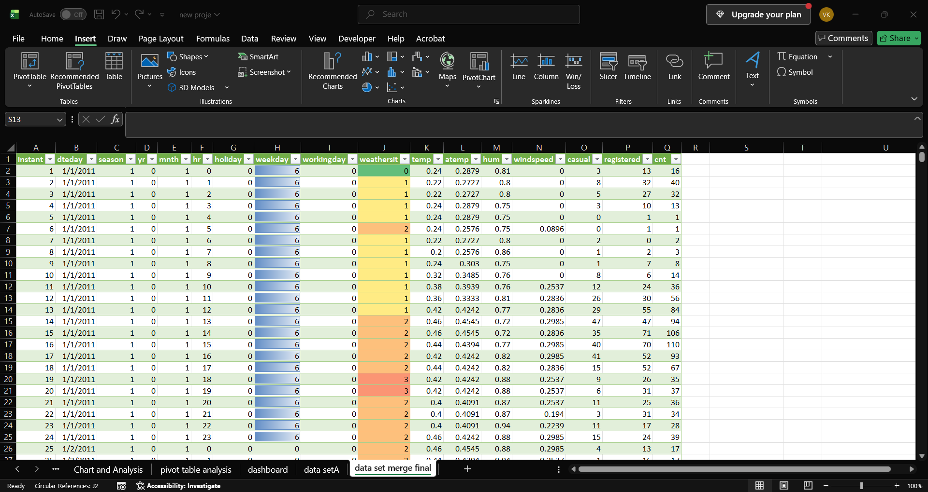
DATASET OVERVIEW:
Dataset Information:
The dataset contains bike rental records and information about weather and seasonal conditions.
IMPORTANT COLUMNS:
. Date
. Season
. Weather situation
. Temperature
. Humidity
. Casual Users
.Registered users
. Total rentals

Slide 5
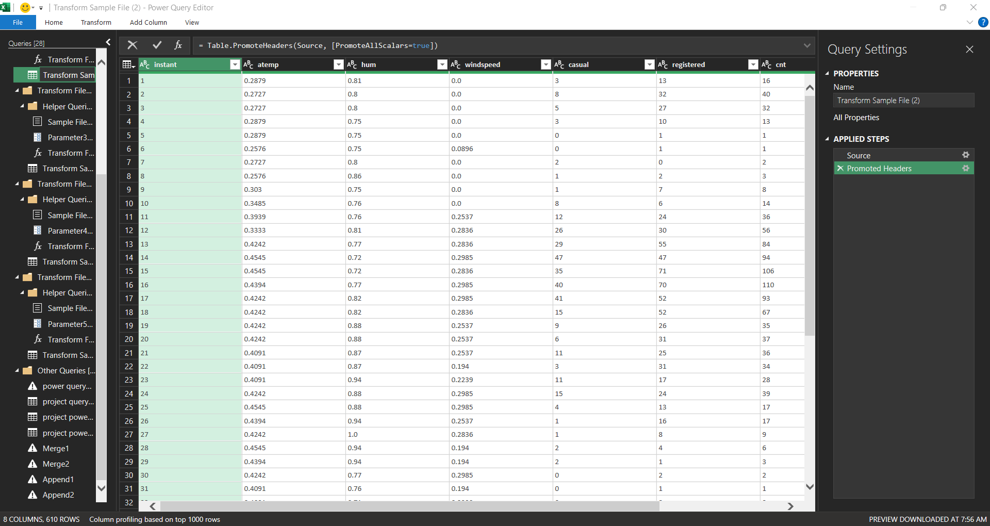
DATA CLEANING
Data cleaning and Transformation-
Data cleaning using power Query
The following operations were performed:
1.Checked missing and null values.
2 .Removed duplicate records where necessary.
3. Correct data types.
4.Cleand the data column.
5. Checked unusual values and data .

Slide 6
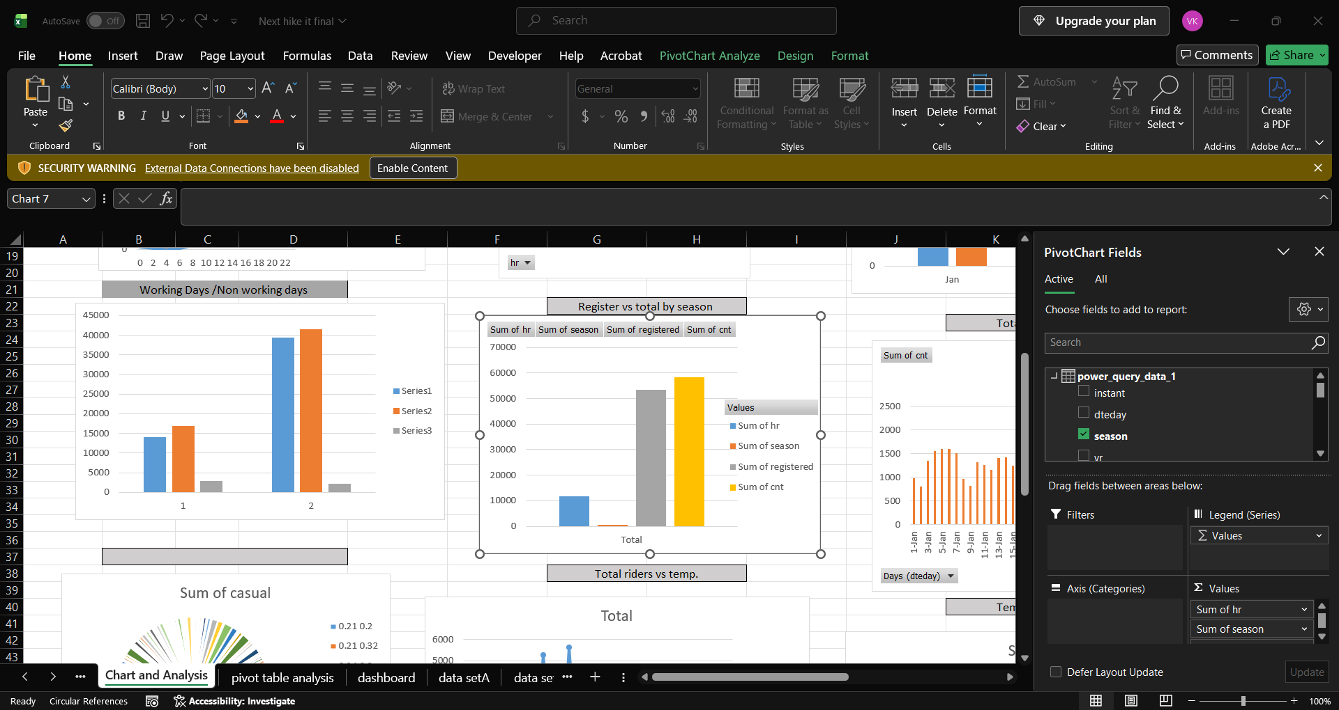
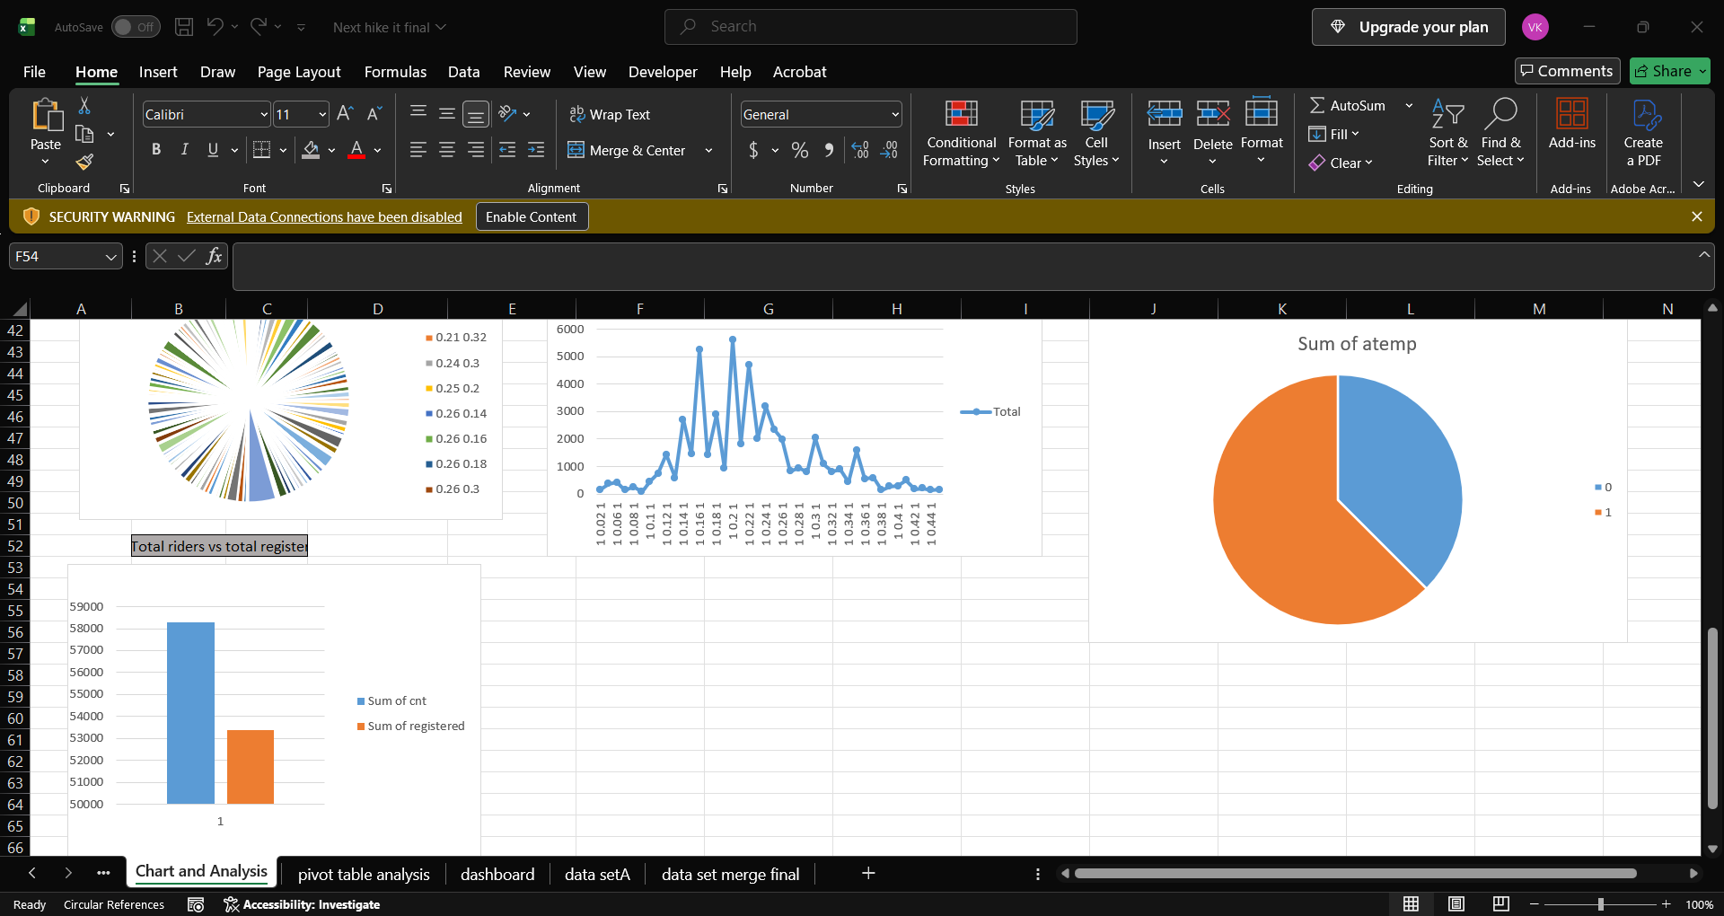
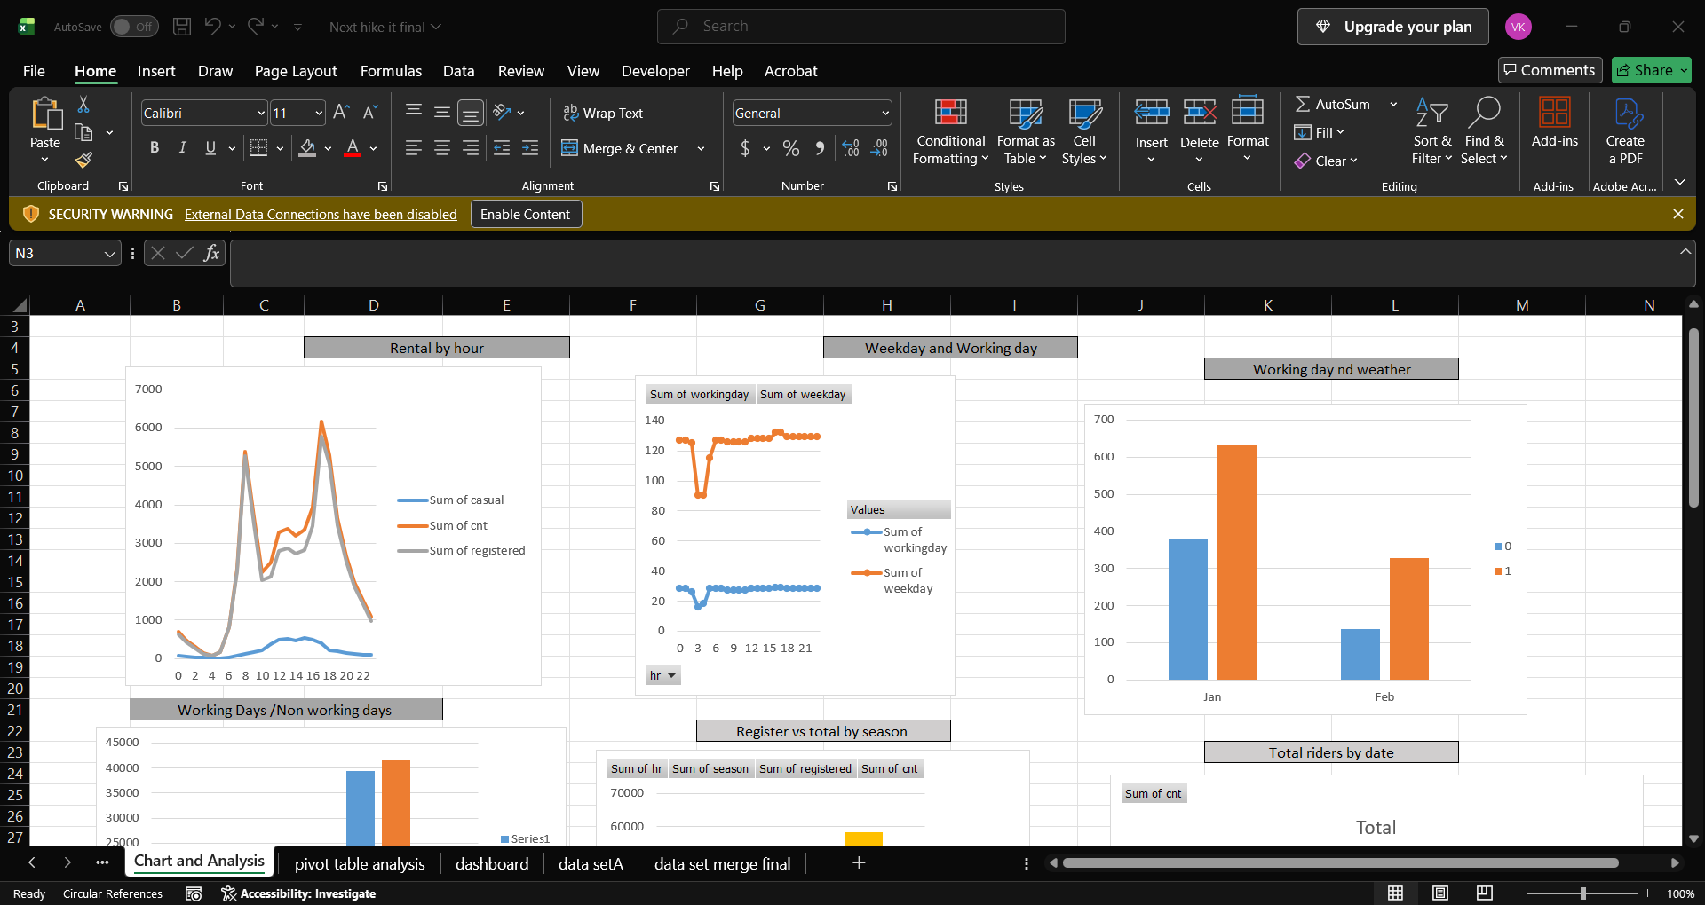
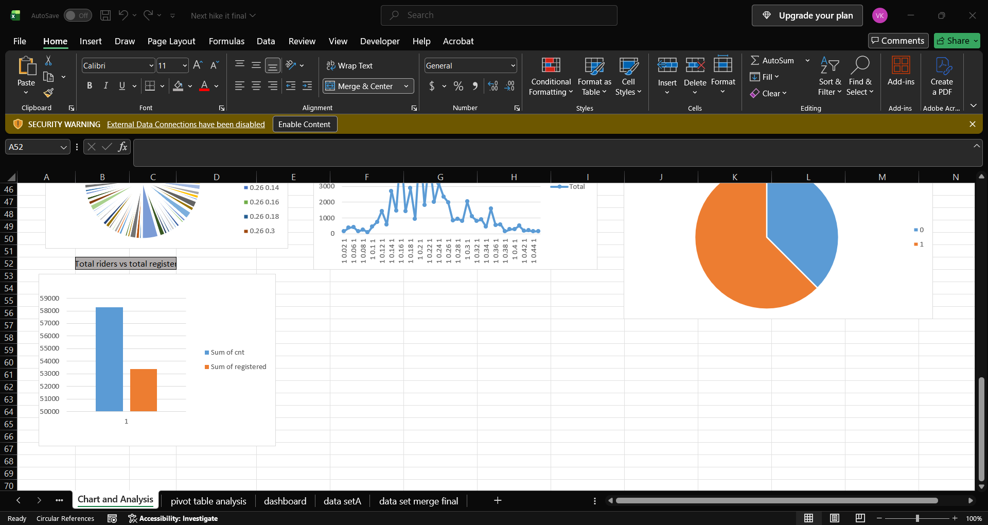
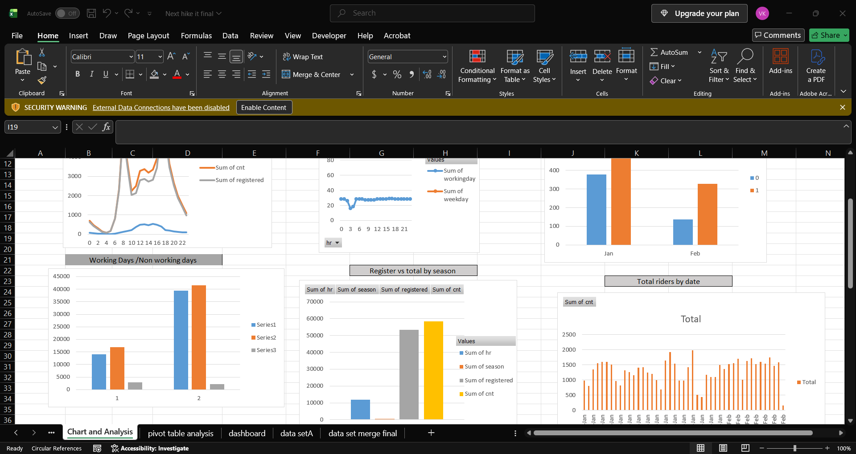

DATA ANALYSIS
Tool used power Bi
Bike Rental Trends over time
Casual vs. Registered users
Bike Rentals by season
Total Bike Rentals
Total Bike Rentals
Working days /Non working days
Working days by weather

Slide 7
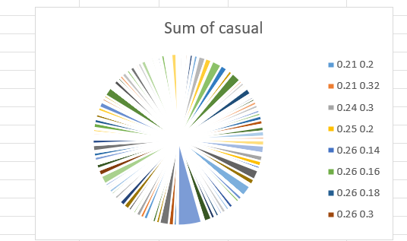


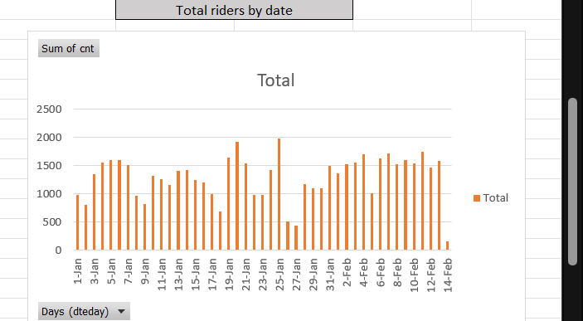
Impact of Temperature on Bike Rentals :

Slide 8
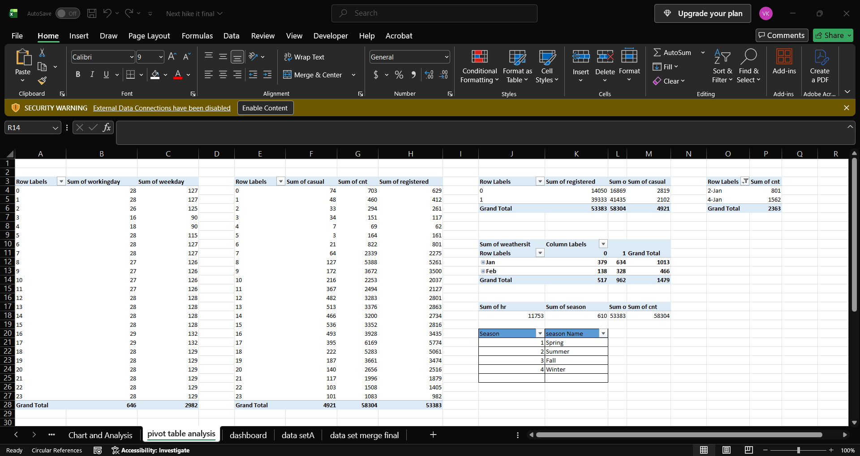
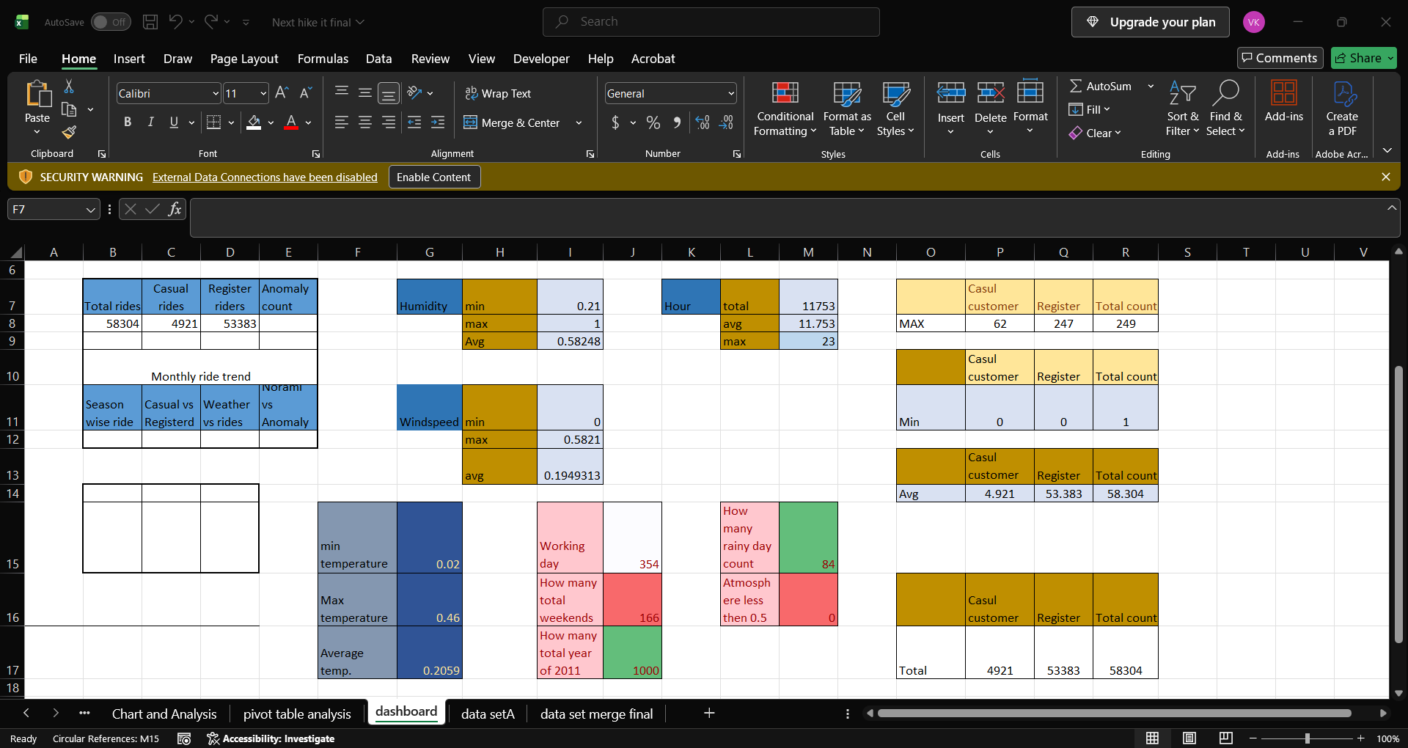

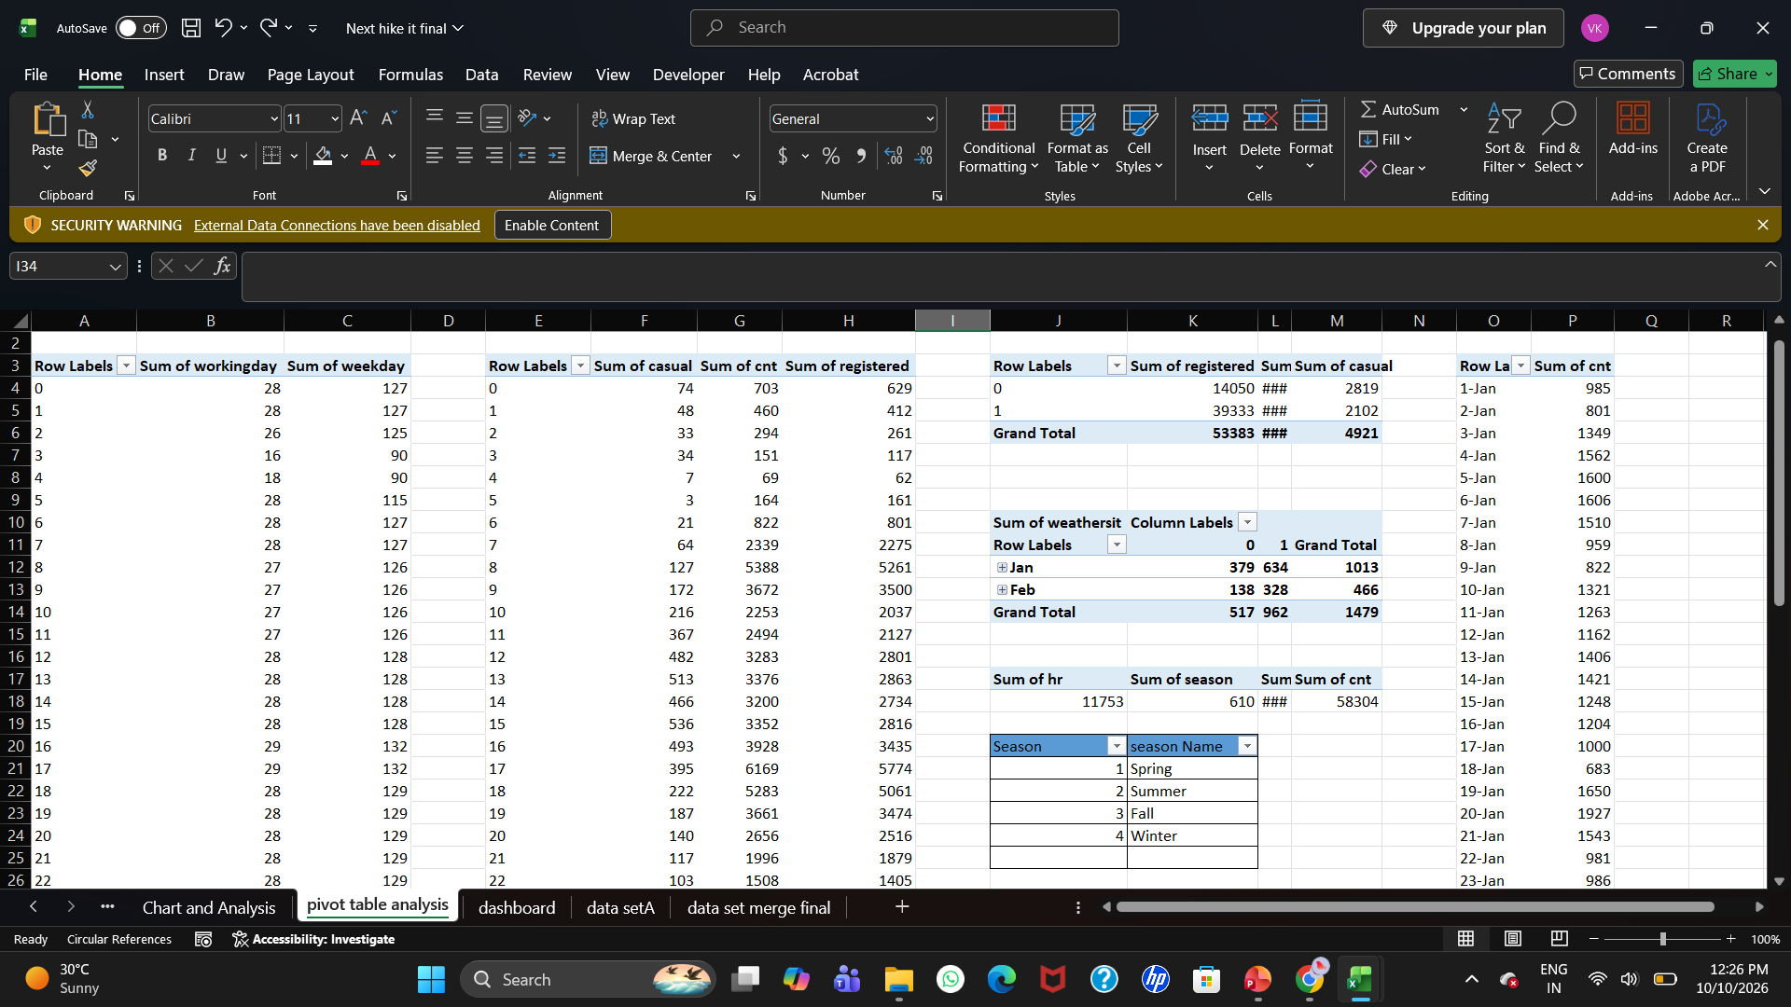
POWER BI DASHBOARD

Slide 9
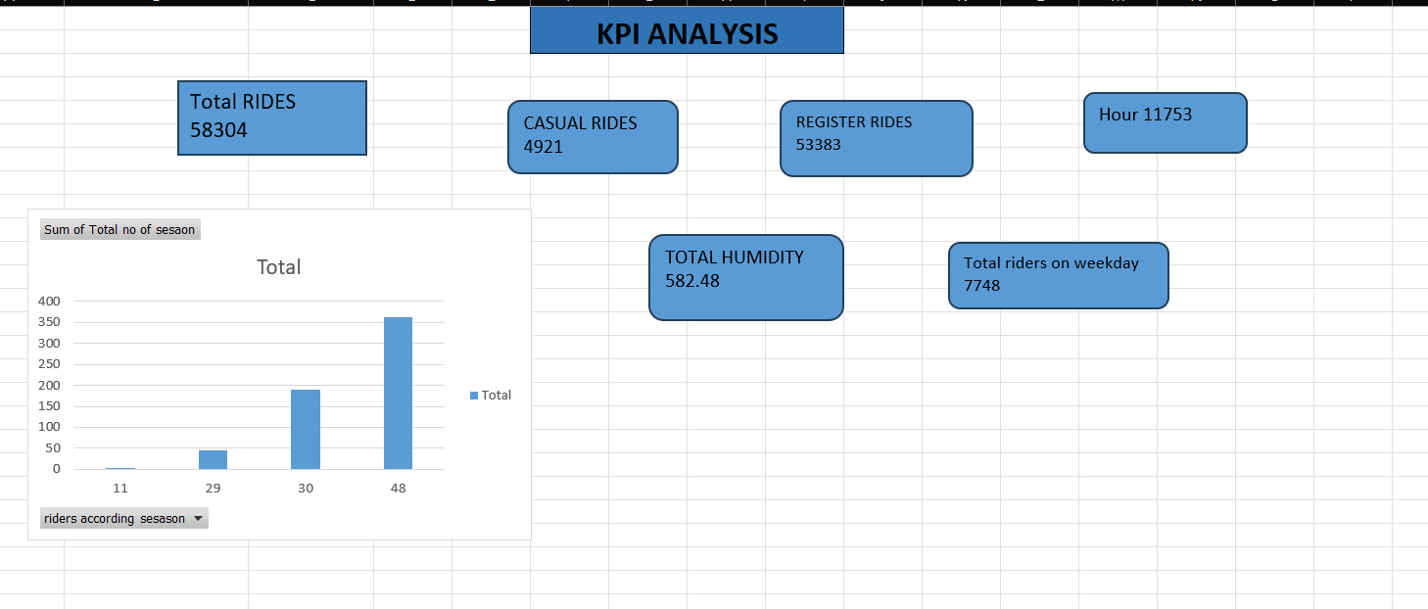
KPI ANALYSIS

Slide 10
RECOMMENDATION
1.Use historical demand patterns to plan bike availability.
2.Monitor rental demand across season.
3. Consider weather conditions when planning operations.
4. Study casual register users separately.

Slide 11
KEY INSIGHTS
Content
Insights from Dashboard
1.Rental demand varies across seasons.
2.Casual and registered users may show different rental patterns.
3.Weather conditions may influence bike rental demand.
4.The dashboard helps identify high- demand and low – demand periods.

Slide 12
CONCLUSION
This project demonstrates how power Query and Power BI can be used to clean ,
Transform, analyze, and visualize bike- sharing data.
The dashboard provides a clear view of rental trends and user demand .

Slide 13
THANK YOU FOR WATCHING

